Slide 1
Eco-System for Successful Impact

Slide 2
Introductions
Sarah Howard
Branch Manager
Research Excellence Branch
ARC
Dr Chris Curran
Director
Research Evaluation

Slide 3
What are we talking about today?
Outline
Key terms – eco-system, impact, success
The Australian eco-system
The ARC – research funding, research assessment
The impact agenda in Australia
The Engagement and Impact Assessment
Insights and questions
How does this apply to you?

Slide 4
What will you get out of this session?
What we will give you:
A detailed example of a national impact assessment
Insights about what works, what doesn’t
Key questions to consider
What you will give yourselves and each other:
Your own examples
Your own insights
Your own questions

Slide 5
How will we do it?
We’ll talk…
Please ask questions along the way
Breakout sessions
consider key questions
report back
Be prepared to be a spokesperson!
We’ll reflect and summarise

Slide 6
Let’s get started

Slide 7
Eco-system for successful impact

Slide 8
What is an eco-system in relation to impact?
Research performers
universities
other publicly funded research organisations
research in industry
Research users
business/industry
cultural/government/not-for-profit sectors
Conditions
economic drivers/funding
government policy/regulations
'impact agenda' - whose?

Slide 9
What does the research impact eco-system in Australia look like?
Research occurs across 42 universities
80,000 people supporting R&D
Higher education - $12.15 (€7.86) billion
Govt support - $8.78 (€5.67) billion
Australian economy is commodity-based, low diversity, low complexity of export mix
90% manufacturing businesses employ less than 20 people

Slide 10
Australian R&D Investment compared to OECD
In 2016, Australia ranked:
15th in government expenditure on R&D as % of GDP
8th in highly cited publications (top 1% in the world)

Slide 11
ARC Responsibilities
ARC
Funding excellent research and research training
Assessing the quality, engagement and impact of research
National Competitive Grants Program (NCGP)
ERA and EI

Slide 12
The impact agenda -
an Australian case study

Slide 13
Australia – impact agenda
What does the impact agenda look like in Australia?
Key Government policies/programs
Distributed across Government Departments
Increasingly strong focus on research impact
Continued support for basic research

Slide 14
Break-out Session 1
five-minutes discussion
one spokesperson for each country
two-minute summary for each question

Slide 15
Break-out Session 1 – Questions
What does the research impact eco-system look like in:
South Africa?
Netherlands?
Spain?
Hungary?
Australia – a university perspective?
What does the national impact agenda look like in your country?

Slide 16
Deep Dive
Australia’s Engagement and Impact Assessment

Slide 17
Why assess research?
*
Six 'A's
Analysis | To understand why, how and whether research is effective, and how it can be better supported
Advocacy | To demonstrate the benefits of supporting research, and enhance the understanding of research and its processes among policymakers and the public
Allocation | To determine how to distribute funding across the research system
Accountability | To evidence that money and other resources have been used efficiently and effectively, and to hold stakeholders to account
Acclaim | To compare and recognise the value of higher education institutions and the research conducted within them
Adaptation | To steer change in organisational structures, behaviours and cultures, and research activites and priorities
RAND - Measuring research: A guide to research evaluation frameworks and tools

Slide 18
Questions to ponder
Which of the six 'A's are most important for your purposes?
Why?
How do your reasons for assessing affect the decisions you make about how to assess?
… we'll come back to this later....

Slide 19
Australia’s Engagement and Impact Assessment
An engagement and impact assessment was announced as part of the Government’s National Innovation and Science Agenda in December 2015
Objective
→ To encourage greater collaboration between universities and end-users of research
Australia ranks poorly amongst the OECD for businesses – higher education collaboration

Slide 20
Australia’s national research assessment framework
Two assessment exercises
Excellence in Research for Australia (ERA): research quality
Engagement and Impact assessment (EI): engagement and impact beyond academia
Universities only (all 42)
Voluntary
Not tied to funding

Slide 21
A short history of research evaluation in Australia
2010–15: First 3 ERA rounds
2018: ERA + EI
2020–21: ERA EI Review
2023: ERA
2024: EI
2021–22: Preparation for next rounds

Slide 22
National research assessment is an important element of an impact agenda...
It is
Supply side (university) focussed
Promotes awareness and cultural change
Applies across the research and discipline spectrum

Slide 23
What is EI exactly?
EI was developed to examine:
how well are researchers in Australian universities engaging with end users beyond academia
what kinds of impacts are occurring outside of academia as result of research undertaken by Australian universities
how well are Australian universities supporting their researchers to deliver research which has an impact beyond academia

Slide 24
What does it do?
EI was developed to encourage innovation and entrepreneurship by…
Encouraging researchers in Australian universities to
better engage with users of their research
better focus on delivering research impacts
Encouraging Australian universities to support their researchers in these activities
It's about changing behaviour in universities – supply side, not demand side

Slide 25
What are we assessing?

Slide 26
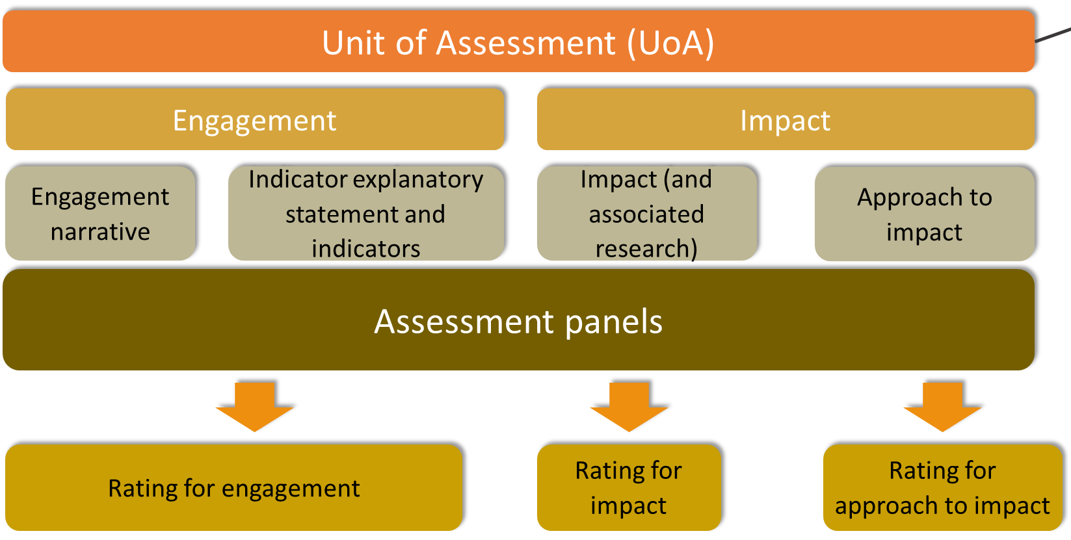
EI 2018 Framework

Slide 27
The unit of assessment
51 Physical sciences
5101 Astronomical sciences
510108 Solar physics
EI
ERA

Slide 28
Definitions matter

Slide 29
EI Definitions: Research Impact
Research impact is the contribution that research makes to the economy, society, environment or culture, beyond the contribution to academic research.

Slide 30
EI Definitions: Research Engagement
Research engagement is the interaction between researchers and research end-users outside of academia, for the mutually beneficial transfer of knowledge, technologies, methods or resources

Slide 31
EI Definitions: Research End-user
A research end-user is an individual, community or organisation external to academia that will directly use or directly benefit from the output, outcome or result of the research

Slide 32
What's the reference period?

Slide 33
EI reference periods
Retrospective or prospective?
EI is retrospective
The reference periods are:
Impact study (6 years)
Associated research (15 years)
Engagement activities (3 years) - not related to impact or associated research
Does it matter what the reference periods are?

Slide 34
How do we assess?

Slide 35
EI assessment methodology
Same methodology for all units of assessment
Almost all qualitative:
Impact case studies
Impact narrative
Approach to impact narrative
Engagement narrative
Universities submit narratives to our ICT system
Engagement indicators - income (and explanatory statement)
Engagement indicators derived from ERA

Slide 36
Assessment Panels
Creative Arts and Humanities
Social Sciences
Aboriginal and Torres Strait Islander Research
Science and Technology
Health and Life Sciences
Assessment panels were on average -
70% academics
30% research end users

Slide 37
EI 2018 Impact Rating Scale
High
The impact has made a highly significant contribution beyond academia.
A clear link between the associated research and the impact was demonstrated.
Medium
The impact has made a significant contribution beyond academia.
A clear link between the associated research and the impact was demonstrated.
Low
The impact has made little or no contribution beyond academia

Slide 38
EI 2018 Approach to Impact Scale
High
Mechanisms to encourage the translation of research into impacts beyond academia are highly effective and well-integrated.
Mechanisms for translating research facilitated the impact described.
Medium
Mechanisms to encourage the translation of research into impacts beyond academia are effective and integrated.
Mechanisms for translating research facilitated the impact.
Low
Mechanisms to encourage the translation of research into impacts beyond academia are not effective and integrated.
Mechanisms for translating research did not facilitate the impact.

Slide 39
EI 2018 Engagement Rating Scale
High
Highly effective interaction between researchers and research end-users outside of academia for the mutually beneficial transfer of knowledge, technologies, methods and resources.
The engagement is well integrated into the development and ongoing conduct of research.
Medium
Effective interactions between researchers and research end-users outside of academia
Engagement is incorporated into relevant parts of the research process or is improving
Low
Little or no effective interactions between researchers and research end-users outside of academia
Little or no evidence that research engagement is incorporated into the research process or is being developed

Slide 40
What were the outcomes of assessment?

Slide 41
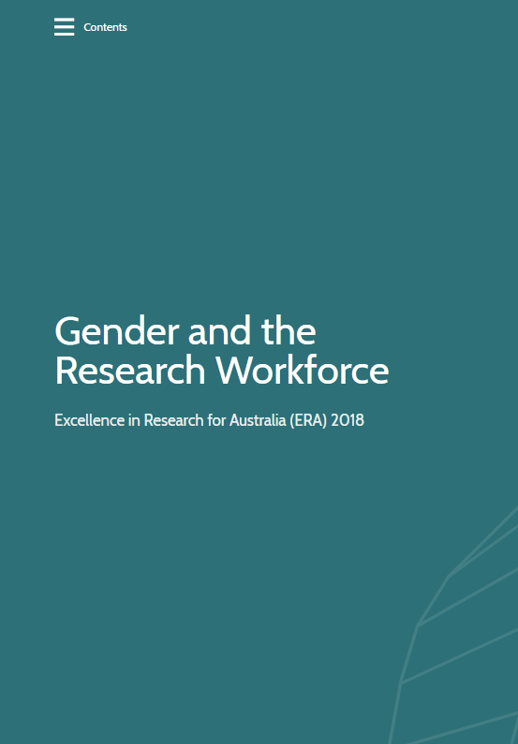
ERA and EI Outcomes Published

Slide 42
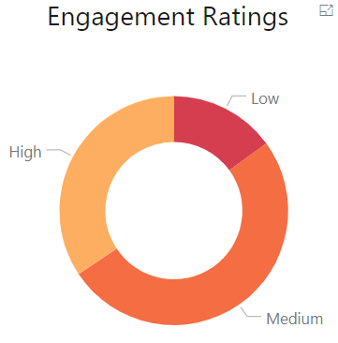
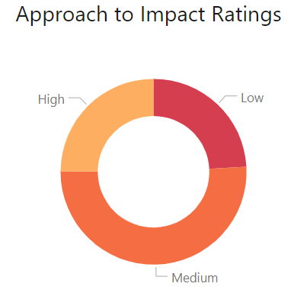
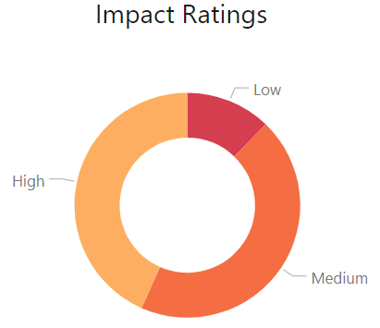
EI 2018 Ratings All universities
34% 51% 15%
25% 51% 24%
43% 44% 12%
Percentages may not total 100 due to rounding

Slide 43
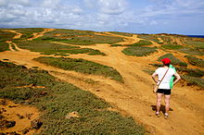
Insights from EI 2018
Many pathways to impact
Many types of collaborations
Impact occurring in many research areas and in different ways
Image source: creative commons

Slide 44
What worked?
What themes were common to impact studies that received a high rating?

Slide 45
Examples of key mechanisms from high rated submissions Engagement Approach to Impact
Collaboration with strategic stakeholders
Public participation (citizen science)
Providing specialist resources and services to external stakeholders
Provision of specialist training or trainee programs
Provision of infrastructure
Support mechanisms for knowledge transfer
Support for ongoing collaboration
Support for multi-disciplinary research centres

Slide 46
High rated Engagement examples- common themes
collaboration with strategic stakeholders
public participation (citizen science)
providing specialist resources and services to external stakeholders
provision of specialist training or trainee programs.

Slide 47
High rated impact and approach to studies - common themes
delivering cutting edge technology with partners
community support and safety
improving everyday life
fostering community
addressing challenges affecting society.

Slide 48
What didn't work?
What themes were common to impact studies that received a low rating?

Slide 49
Low rated impact studies - common themes
Insufficient evidence
Potential impacts
Unclear impacts
Ineligible activities
Unclear link to research

Slide 50
Low rated approach to impact - common themes
Not university-driven
Business as usual
Not strategic

Slide 51
Break-out Session 2
Break into 3 groups
15 minutes discussion
Report back
one spokesperson for each group
five-minute summary for each

Slide 52
Break-out session 2 – back to the six ‘A’s
*
Six 'A's
Analysis | To understand why, how and whether research is effective, and how it can be better supported
Advocacy | To demonstrate the benefits of supporting research, and enhance the understanding of research and its processes among policymakers and the public
Allocation | To determine how to distribute funding across the research system
Accountability | To evidence that money and other resources have been used efficiently and effectively, and to hold stakeholders to account
Acclaim | To compare and recognise the value of higher education institutions and the research conducted within them
Adaptation | To steer change in organisational structures, behaviours and cultures, and research activites and priorities
RAND - Measuring research: A guide to research evaluation frameworks and tools

Slide 53
Break-out Session 2 – Questions
Which of the six ‘A’s should be most prominent for research assessment in your impact eco-system?
How does this affect the practical choices of assessment for
What you assess – level, unit of assessment, definitions?
How you assess – expert panels, rating scale?
What outcomes you expect – performance, behaviours?
What other factors should you consider?

Slide 54
Bringing it back to the eco-system

Slide 55
Two approaches to research assessment
EI
Selective sampling
ERA
Comprehensive
Broad disciplines and specific fields
Broad disciplines
Narratives and quantitative data
Citation analysis or peer review
Expert review
Expert review

Slide 56
How ERA drives change
Reputational lever for policy change
Originally moderated a small proportion of research funding
Universities incorporate ERA outcomes into their strategic planning

Slide 57
How EI drives change
Focuses universities on research engagement, translation and impact
Highlights pathways to collaboration
Universities incorporate EI outcomes into their strategic planning

Slide 58
Value of ERA and EI
Focus universities and researchers on research quality and on research that has direct impacts on the economy, society, environment and culture.
Other uses and users include:
Uses
Strategic planning, management and promotion
Identifying areas of research strength and expertise, and opportunities for development
Users
Identifying pathways and partners for collaboration
Informing policies and programs
Assurance - return on investment
Universities
Students
Government
Industry
Taxpayers

Slide 59
Bringing it back to the eco-system
Key features of the Australian eco-system | Key features Engagement and Impact assessment
Most research conducted by universities Government provides significant proportion of funding to universities | Focus of assessment is universities
Australia has lower levels of engagement than some comparable countries Many government programs aim to encourage engagement and impact across the social, environmental, economic and cultural sectors. | Assessment helps focus university behaviour Assessment captures broad range of impacts across all disciplines and sectors Narrative assessment is prominent
Australian Government funds university research across all disciplines Universities already collect and report data to government by discipline ERA and EI are companion exercises | Unit of assessment is the research discipline at the university Quality (through ERA), engagement and impact are assessed separately

Slide 60
Bringing it back to the eco-system – your turn
What does your eco-system for successful research impact look like?
How does this change your approach to impact assessment?
How would you measure success for your assessment system?

Slide 61
Thank you
Questions:
ARC-EI@arc.gov.au
www.arc.gov.au

